Slide 1
MYSQL PROJECT

Slide 2
INTRODUCTION TO SQL
SQL stands for the structured query language.
SQL is the standardized language used to access the database.
SQL is composed of three parts:
1.Data definition language (DDL) includes statements for defining the database and its objects such as tables, views, triggers, stored procedures etc.
2.Data manipulation language (DML) contains statements for updating and querying data.
3.Data control language (DCL) allows you to grant permissions to users to access specific data in the database.

Slide 3
SQL SERVERS
SQL Server is an application software for Relational Database Management System (RDBMS), from Microsoft, that can be used for creating, maintaining, managing, and implementing the RDBMS systems.
ADVANTAGES:
Data Processing
High Storage
Integration With Front-end
Easy to Connect With .Net

Slide 4
DBMS AND RDBMS
Database Management System (DBMS) is a software that is used to define, create and maintain a database and provides controlled access to the data.
RDBMS stands for Relational Database Management System.
A relational database is the most commonly used database. It contains several tables, and each table has its primary key.

Slide 5
DIFFERENCE BETWEEN DBMS AND RDBMS
DBMS
RDBMS
DBMS applications store data as file.
DBMS uses file system to store data, so there will be no relation between the tables.
Security is less.
It supports single user and handle small amount of data.
RDBMS applications store data in a tabular form.
In RDBMS, data values are stored in the form of tables.
More security measures provided.
It supports multiple users and handle large amount of data.

Slide 6
DATABASE AND SQL DATA TYPE
A database Is an organized collection of data, so that it can be easily accessed and managed.
SQL Data Type
Numeric Data type
Date & Time Data type
String Data type

Slide 7
NUMERIC DATA TYPE
DATA TYPE | DESCRIPTION
BIT | Boolean type with values 0 (false), 1 (true), or NULL. Default is 1.
TINYINT | Tiny whole numbers from 0 to 255.
SMALLINT | Small whole numbers from -32,768 to 32,768.
INT | Whole numbers from -2,147,483,648 to 2,147,483,648.
BIGINT | Large whole numbers from -9,223,372,036, 854,775,808 to 9,223,372,036, 854,775,808.
DECIMAL | Fixed-point and scale number from -10^38 +1 to 10^38 +1.
NUMERIC | Same as decimal. Fixed-point and scale from -10^38 +1 to 10^38 +1.
FLOAT | Floating point number from -1.79E + 308 to 1.79E + 308.
REAL | Floating point number from -3.40E + 38 to 3.40E + 38.
SMALLMONEY | Monetary value from -214,748.3648 to 214,748.3647.
MONEY | Monetary value from -922,337,203,685,477.5808 to 922,337,203,685,477.5807.

Slide 8
DATE AND TIME DATA TYPE
DATA TYPE | DESCRIPTION
DATE | Date in YYYY-MM-DD format. Supported range is from 1000-01-01 to 9999-12-31.
TIME | Time in hh:mm:ss[.nnnnnnn] format. Supported range is from 00:00:00.0000000 to 23:59:59.9999999.
DATETIME2 | Date and time in YYYY-MM-DD hh:mm:ss[.nnnnnnn] format. Date range is 0001-01-01 to 9999-12-31. Time range is 00:00:00 to 23:59:59.9999999.
DATETIMEOFFSET | Datetime with timezone in YYYY-MM-DD hh:mm:ss[.nnnnnnn] [{+|-}hh:mm] format. Date range is 0001-01-01 to 9999-12-31. Time range is 00:00:00 to 23:59:59.9999999. Timezone range is -14:00 to +14:00.
SMALLDATETIME | Date and time in YYYY-MM-DD hh:mm:ss format. Date range is 1900-01-01 to 2079-06-06. Time range is 00:00:00 to 23:59:59.
DATETIME | Date and time in YYYY-MM-DD hh:mm:ss[.nnn] format. Date range is 1753-01-01 to 9999-12-31. Time range is 00:00:00 to 23:59:59.997.

Slide 9
STRING DATA TYPES
DATA TYPE | DESCRIPTION | MAX SIZE
CHAR | Fixed length character string | 8,000 characters
NCHAR | Fixed length Unicode string | 4,000 characters
VARCHAR | Variable-length character string | 8,000 characters
NVARCHAR | Variable-length Unicode string | 4,000 characters
VARCHAR(Max) | Variable-size character storage The max indicates maximum characters | 2GB of data
NVARCHAR(Max) | Variable-size Unicode storage The max indicates maximum characters | 2GB of data
TEXT | Variable-length character string | 2GB of data
NTEXT | Variable-length Unicode string | 1GB of data

Slide 10
INTRODUCTION TO MYSQL
MySQL is a robust and versatile open-source relational database management system (RDBMS).
It stores data in tables and Every table is made up of rows and columns.
Rows represent individual records, and columns represent different pieces of data about each record.

Slide 11
MY SQL MAIN COMMANDS
Create database (Create a New Database)
Show Database (View Database)
Drop Database
Alter Database (Modify Database)
Create Tables
Show tables
Insert Values
Drop Table
Alter table ( For New Column Creation)
Alter Table Modify
Alter table Drop ( Drop the Column)
Alter table Rename (Rename the Table)
Update Table ( To change the Values)
Delete Statement

Slide 12
Create database (Create a New Database)
create database empprocess;
use empprocess;
create table emp_process(emp_no int,emp_name varchar(100),designation varchar(100),dep_no int,date_of_join date,primary key(emp_no));
insert into emp_process values
(17001,'Geetha','Manager',50,'2022-05-10’),
(17002,'Guru','Junior Associates',50,'2022-05-12’),
(17003,'Gokul','Senior Manager',50,'2022-05-15’),
(17004,'Mani','HR',60,'2022-05-20’),
(17005,'Moorthy','General Manager',50,'2022-05-23’),
(17006,'Amutha','Team Lead',50,'2022-06-05’),
(17007,'Jaga','Senior Manager',70,'2022-06-06’),
(17008,'Pavithra','Senior HR',60,'2022-06-07’),
(17009,'Arthi','General Manager',50,'2022-06-08’),
(17010,'Kabilan','Team Lead',70,'2022-06-09’),
(17011,'Manasi','Manager',70,'2022-06-10’),
(17012,'Suja','Junior Associates',50,'2022-06-11’),
(17013,'Arun','Senior Manager',60,'2022-06-12’),
(17014,'Sindhu','General Manager',80,'2022-06-14’),
(17015,'Deepa','HR',60,'2022-06-13'),
(17016,'Madhavi','Junior Associates',50,'2022-06-15’),
(17017,'Swetha','Junior Associates',70,'2022-06-16’),
(17018,'Selvi','Junior Associates',70,'2022-06-17’),
(17019,'Pooja','Junior Associates',70,'2022-06-18’),
(17020,'Lakshmi','Junior Associates',70,'2022-06-19’),
(17021,'Veeramani','Junior Associates',80,'2022-06-20’),
(17022,'Pandian','Junior Associates',80,'2022-06-21’),
(17023,'Veera','Junior Associates',80,'2022-06-22’),
(17024,'Devi','General Manager',70,'2022-06-23’),
(17025,'Devan','Team Lead',60,'2022-06-24’),
(17026,'Keerthi','Manager',60,'2022-06-25’),
(17027,'Venkatesh','Senior Manager',80,'2022-06-26’),
(17028,'Raja','HR',60,'2022-06-27’),
(17029,'Priya','General Manager',70,'2022-06-28’),
(17030,'mariya','Team Lead',80,'2022-06-29’),
(17031,'srinivasan','General Manager',70,'2022-06-30’),
(17032,'ganesan','Team Lead',80,'2022-07-01’),
(17033,'Praveen','Manager',80,'2022-07-02’);
select*from emp_process;

Slide 13
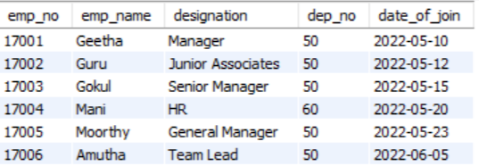
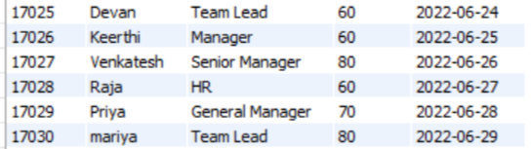
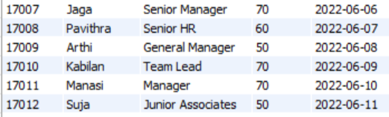

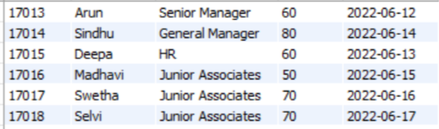
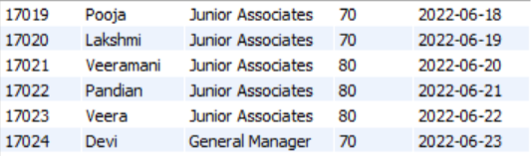

Slide 14

Show Database (View Database)
show database;
Drop Database
drop database empprocess;

Slide 15
Alter Database (Modify Database)
ALTER DATABASE is an essential statement to modify the properties of an existing database in a Relational Database Management System (RDBMS). This statement is helpful if you want to rename a database, change its composition, or modify file properties.

Slide 16
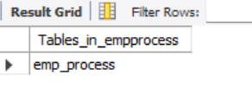
Create Tables
create table emp_process(emp_no int,emp_name varchar(100),designation varchar(100),dep_no int,date_of_join date,primary key(emp_no));
Show tables
show tables;

Slide 17
Insert Values
insert into emp_process values
(17001,'Geetha','Manager',50,'2022-05-10'),
(17002,'Guru','Junior Associates',50,'2022-05-12'),
(17003,'Gokul','Senior Manager',50,'2022-05-15'),
(17004,'Mani','HR',60,'2022-05-20'),
(17005,'Moorthy','General Manager', 50,'2022-05-23'),
(17006,'Amutha','Team Lead',50,'2022-06-05'),
(17007,'Jaga','Senior Manager',70,'2022-06-06'),
(17008, 'Pavithra',’Senior HR',60,'2022-06-07'),
(17009,'Arthi','General Manager',50,'2022-06-08'),
(17010,'Kabilan','Team Lead',70,'2022-06-09'),
(17011,'Manasi','Manager',70,'2022-06-10'),
(17012,'Suja','Junior Associates',50,'2022-06-11'),
(17013,'Arun','Senior Manager',60,'2022-06-12'),
(17014,'Sindhu','General Manager',80,'2022-06-14'),
(17015,'Deepa','HR',60,'2022-06-13'),
(17016,'Madhavi','Junior Associates',50,'2022-06-15'),
(17017,'Swetha','Junior Associates',70,'2022-06-16'),
(17018,'Selvi', 'Junior Associates',70,'2022-06-17'),
(17019,'Pooja','Junior Associates',70,'2022-06-18'),
(17020,'Lakshmi','Junior Associates',70,'2022-06-19'),
(17021,'Veeramani','Junior Associates',80,'2022-06-20'),
(17022,'Pandian','Junior Associates',80,'2022-06-21'),
(17023,'Veera','Junior Associates',80,'2022-06-22'),
(17024,'Devi','General Manager',70,'2022-06-23'),
(17025,'Devan','Team Lead',60,'2022-06-24'),
(17026,'Keerthi','Manager', 60,'2022-06-25'),
(17027,'Venkatesh','Senior Manager',80,'2022-06-26'),
(17028,'Raja','HR',60,'2022-06-27'),
(17029,'Priya','General Manager',70,'2022-06-28'),
(17030,'mariya','Team Lead',80,'2022-06-29'),
(17031,'srinivasan','General Manager',70,'2022-06-30'),
(17032,'ganesan','Team Lead',80,'2022-07-01'),
(17033,'Praveen','Manager',80,'2022-07-02');

Slide 18
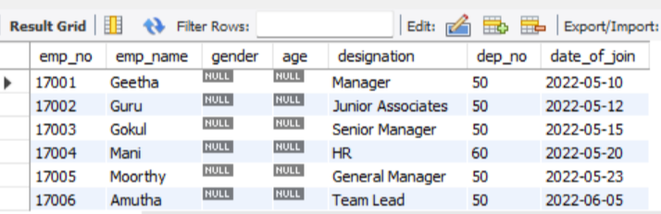
Drop Table
drop table emp_process;
Alter table ( For New Column Creation)
alter table emp_process add gender varchar(20) after emp_name;
alter table emp_process add age int after gender;

Slide 19
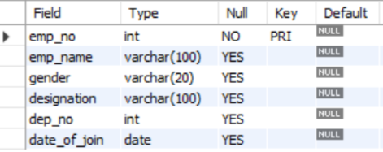
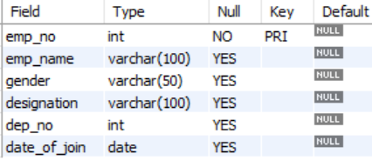
Alter Table Modify
From the above description gender having characters of 20,by using alter modify we used to change gender varchar(20) to gender varchar(50)
The below description represents the alter modify of gender column changes the character values from 20 to 50
Query → alter table emp_process
modify gender varchar(50)null;

Slide 20
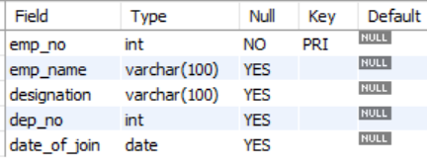
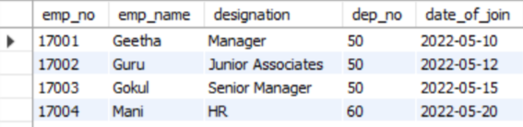
Alter table Drop ( Drop the Column)
alter table emp_process
drop column gender;
By using the alter drop method we removed a column from table
→description of table which removes gender field
→By using alter drop it removes the gender column from the table

Slide 21
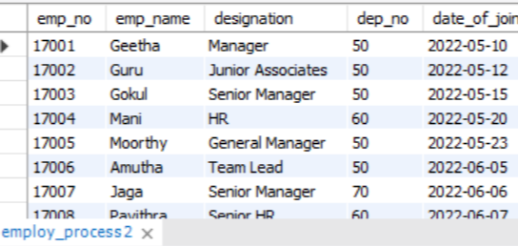
Alter table Rename (Rename the Table)
alter table emp_process rename employ_process;
The above picture which represents the rename of the table name using alter table rename method

Slide 22


Update Table ( To change the Values)
→before changing value at rows in table
update sal_det set amount=40000 where sal_id=18001;
update sal_det set amount=35000 where sal_id=18002;
The above table represents the salary amount value changed for 2 employees

Slide 23
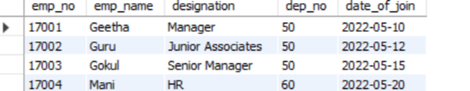
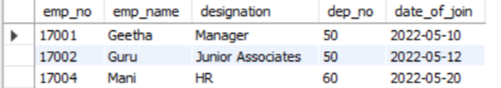
Delete Statement
→Before deleting rows in table
delete from emp_process where emp_no=17003;
The above picture which deletes the row of emp_no =‘17003’in the table

Slide 24
My SQL General Functions
Where
or
and
in
Not in
>
<
>=
<=
<> (Not in)
!
Count
Distinct
Count With Distinct
Order by Asc
Order By Desc
Group By
Limit
Desc Limit
Like (_%)
Not like
Between

Slide 25
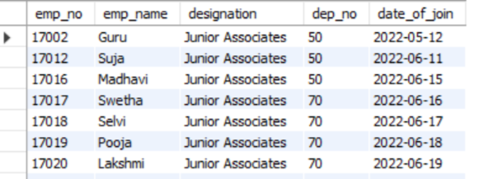
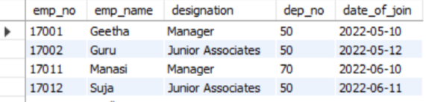
Where
select*from emp_process where designation='Junior Associates’;
Or
select*from emp_process where designation='Junior Associates'or designation='Manager';

Slide 26
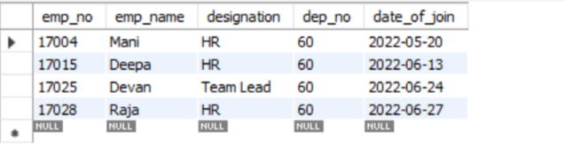
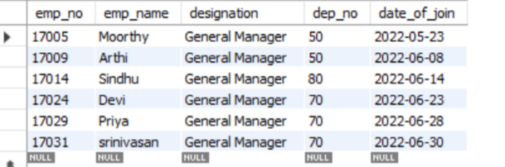
And
select*from emp_process where designation in ('HR','Team Lead')and dep_no=60;
In
select*from emp_process where designation in ('General Manager’);

Slide 27
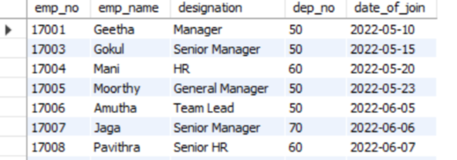
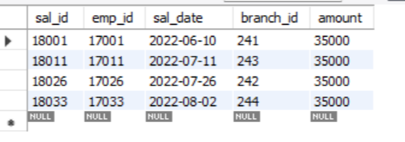
Not In
select*from emp_process where designation not in ('Junior Associates’);
→ Table represents the data who are not in ‘Junior Associates’
>
select*from sal_det where amount>30000;
→Table which represents amount greater than ‘30000’

Slide 28
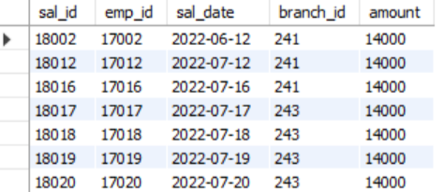
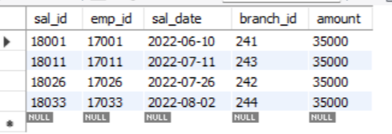
<
select*from sal_det where amount<15000;
→Table which represents amount less than ‘15000’
> =
select*from sal_det where amount>=35000;
→Table which represents amount greater than equal to ‘35000’

Slide 29
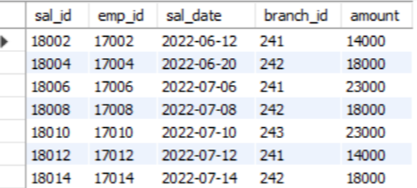
< =
select*from sal_det where amount<=25000;
The above table which represents amount less than or equal to ‘25000’

Slide 30
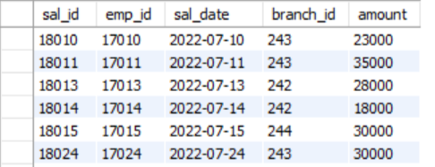
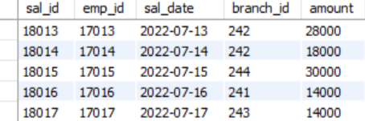
< > ( Not In)
select*from sal_det where amount<>14000;
→ Table which represents amount not in ‘14000’
!
select*from sal_det where amount!=21000;
→ Table which represents amount not equal to ‘21000’

Slide 31

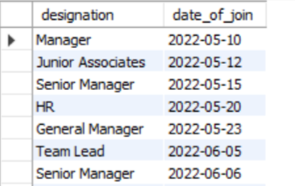
Count
select count(emp_no)from emp_process where designation='HR';
→Displays the total count of designation=‘HR’
Distinct
select distinct designation,date_of_join from emp_process;
→Displays the Designation and date of join using distinct command

Slide 32

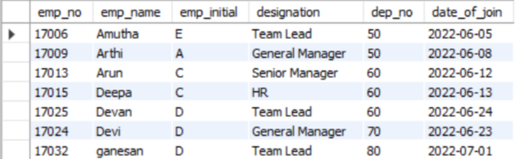
Count With Distinct
select count(distinct emp_no)from emp_process where designation='Junior Associates';
Order by Asc
select*from emp_process order by emp_name asc;

Slide 33
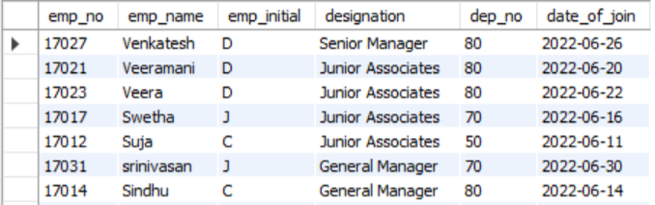
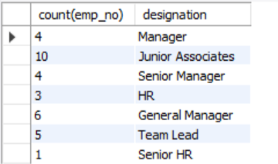
Order by Desc
select*from emp_process order by emp_name desc;
Group by
select count(emp_no),designation from emp_process group by designation;

Slide 34
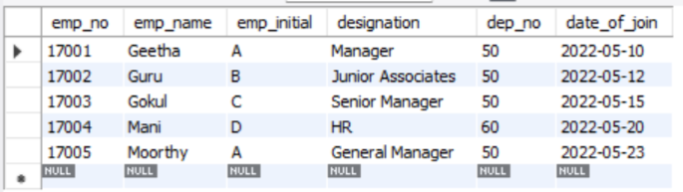
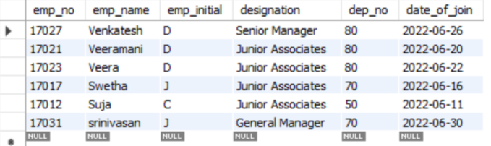
Limit
select*from emp_process limit 5;
Desc Limit
select*from emp_process order by emp_name desc limit 6;

Slide 35
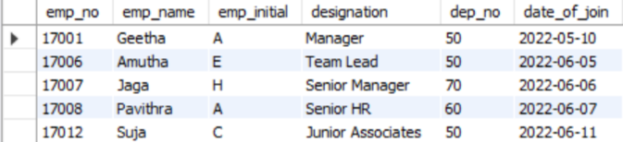

Like(_%)
select*from emp_process where emp_name like '%a';
select*from emp_process where emp_name like '%or%';

Slide 36
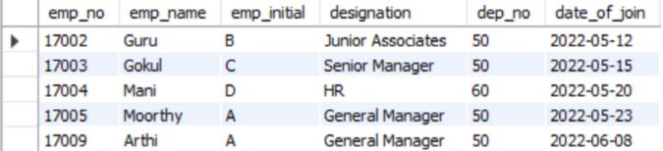
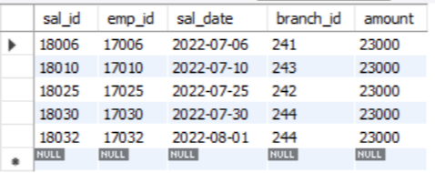
Not like
select*from emp_process where emp_name not like '%a';
Between
select*from sal_det where amount between 20000 and 25000;

Slide 37
MY SQL Calculate Functions
Sum
Average
Min
Max
Count

Slide 38

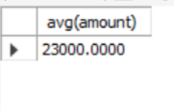
SUM
select sum(amount)from sal_det;
AVERAGE
select avg(amount)from sal_det;

Slide 39



MAX
select max(amount)from sal_det;
COUNT
select count(amount)from sal_det where amount >= 30000;
MIN
select min(amount)from sal_det;

Slide 40
My SQL String Functions
Lcase
Ucase
Left
Right
Concat
Trim
Char_length
Mid
Length

Slide 41
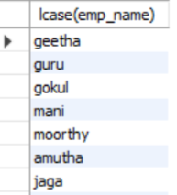
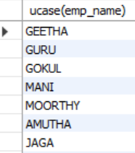
Lcase
select lcase(emp_name) from emp_process;
Ucase
select ucase(emp_name) from emp_process;

Slide 42
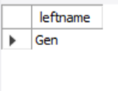

Left
select left('General Manager',3) as leftname;
Right
select right('Team Lead',7) as rightname;

Slide 43
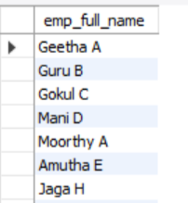
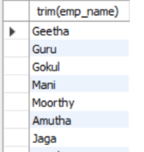
Concat
select concat(emp_name, " ", emp_initial) as emp_full_name from emp_process;
Trim
select trim(emp_name) from emp_process;

Slide 44
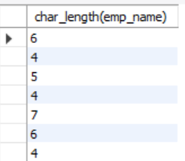
Char_length
select char_length(emp_name) from emp_process;

Slide 45

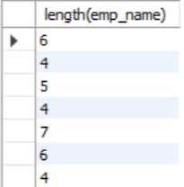
Mid
select mid('Junior Associates',3,5) as middlename;
Length
select length(emp_name) from emp_process;

Slide 46
My SQL Date Functions
Date ADD
Datediff
Timestamp Diff
Date Format
Year
Day
Month
Now

Slide 47


Date ADD
select date_add("2022-06-21", interval 4 month)as exp_month;
Date Diff
select datediff("2022-06-23", "2022-06-18")as exp_days;

Slide 48

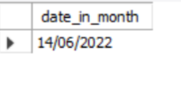
Timestamp Diff
select timestampdiff(month,'2022-05-10','2022-07-02')as exp_in_months;
Date Format
select date_format('2022-06-14','%d/%m/%Y')as date_in_month;

Slide 49


Year
select * from emp_process where year(date_of_join)= '1980';
Day
select * from emp_process where day(date_of_join)='02';

Slide 50
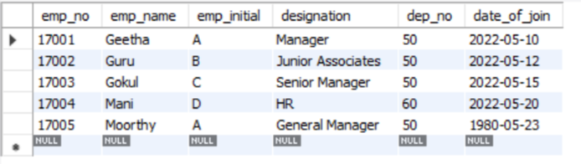

Month
select * from emp_process where month(date_of_join)='05';
Now
select now()as current_date_and_time;

Slide 51
Logical Functions
If
If with and conditons
If with or conditions
Count If

Slide 52
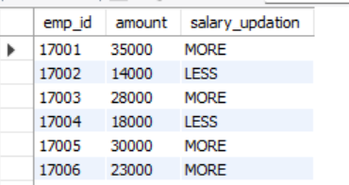
If
select emp_id,amount,if(amount>20000,"MORE","LESS")as salary_updation from sal_det;
Count If
COUNT() function includes IF() function, which has a condition specified.
If the <condition> is true, then the count will be calculated based on <expression> passed. Else, NULL is passed in the count() function. In case NULL is passed to count(), it will not get the count of the results, instead it will get the count of the null values in the column your_column_name.
The DISTINCT keyword is optional.
alias_name is the name you give to the count results.
your_table_name is the name of the table from which you want to get the count.

Slide 53
Example:
Get the count of students who got Grade A, Grade B, GRADE C, and Grade D, respectively.
SELECT COUNT(DISTINCT student_id) AS TotalStudents,
COUNT(DISTINCT IF(student_grade = 'A',student_id,NULL)) AS A_GradeHolders,
COUNT(DISTINCT IF(student_grade = 'B',student_id,NULL)) AS B_GradeHolders,
COUNT(DISTINCT IF(student_grade = 'C',student_id,NULL)) AS C_GradeHolders,
COUNT(DISTINCT IF(student_grade = 'D',student_id,NULL)) AS D_GradeHolders FROM students_data;
Result:

Slide 54
RDBMS SYSTEM
Two table connection
Three table connection

Slide 55
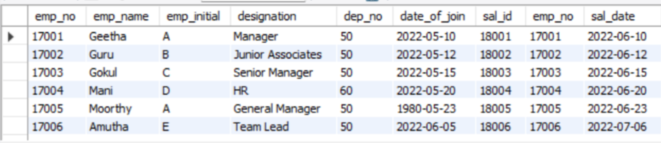
Two Table Connection
SELECT*FROM emp_process INNER JOIN sal_det ON emp_process.emp_no = sal_det.emp_no;

Slide 56
Three Table Connection
select Student_det.Student_id, Student_det.student_name,Student_det.City_state, Student_det.Roll_no,Course_info.course_id,Course_info.Course_name, Marks_info.marks_id,Marks_info.finance,Marks_info.cost, Marks_info.corporate fromStudent_det right join course_info onStudent_det.Course_id = Course_info.course_id left joinmarks_info on Student_det.Student_id = Marks_info.Student_idorder by Student_det.Student_id;

Slide 57
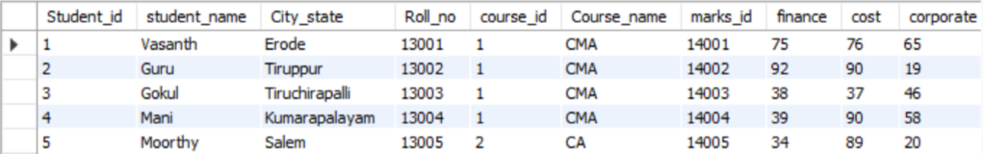
The above screenshot represents three table connection

Slide 58
Join Queries
- Inner Join
- Left Join
- Right Join
- Cross join
- Full Outer Join
- Case and end
- when
- then
- double case with end statement
- case with and statement
- case with or statement
- RDBMS with subqueries
- having clause
- basic joins Trigger (Create table after connections)

Slide 59
Join
Joins are a way of displaying data from multiple tables
Inner Join
The default join is called an inner join. In MySQL, this can be specified using either INNER JOIN, just JOIN, or CROSS JOIN.
Example:
SELECT*FROM emp_process INNER JOIN sal_det ON emp_process.emp_no = sal_det.emp_no;

Slide 60
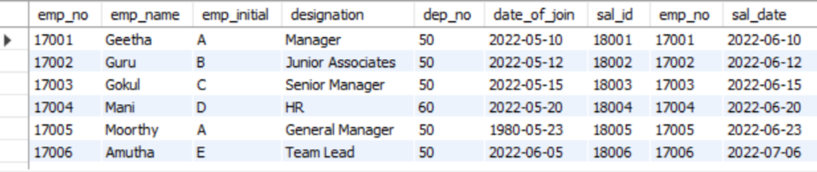
2. Left Join
A left join is a join that shows all of the records found in an inner join, plus all of the unmatched rows from the first table. In MYSQL, this can be specified as a LEFT OUTER JOIN or as just a LEFT JOIN
Example:
SELECT*FROM emp_process LEFT JOIN sal_det ON emp_process.emp_no = sal_det.emp_no;

Slide 61
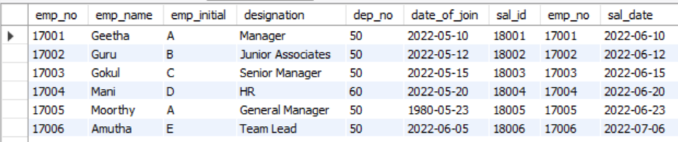
3. Right Join
A right join is a join that shows all of the records found in an inner join, plus all of the unmatched rows from the second table. In MySQL, this can be specified as a RIGHT OUTER JOIN or as just a RIGHT JOIN.
Example:
SELECT*FROM emp_process RIGHT JOIN sal_det ON emp_process.emp_no = sal_det.emp_no;

Slide 62
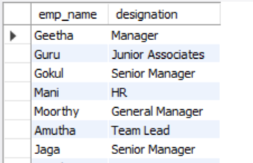
4. Cross Join
CROSS JOIN keyword returns all matching records from both tables whether the other table matches or not.
Example:
SELECT emp_process.emp_name,emp_process.designation FROM emp_process CROSS JOIN sal_det where emp_process.emp_no=sal_det.emp_no;

Slide 63

5. Full Outer Join
FULL JOIN or a FULL OUTER JOIN is a type of Outer Join that combines records from both the left table and the right table. When there is no match at a given position then NULL is being displayed at that particular position. A Full Join is a combination of both the Left Outer Join and the Right Outer Join. We can perform the FULL JOIN both with and without the WHERE clause.
Example:
SELECT ID,NAME,BOOK_ID,BOOK_NAME FROM STUDENTS FULL JOIN LIBRARY ON ID=BOOK_ID WHERE BRANCH='CS';

Slide 64

Example:(Full Outer Join Or Union)
(select * from emp_det left join Sal_det onemp_det.Emp_id = sal_det.EMP_id)union(Select * from emp_det right join Sal_det onemp_det.Emp_id = sal_det.Emp_id);

Slide 65

6. Case and end
The CASE statement goes through conditions and return a value when the first condition is met (like an IF-THEN-ELSE statement). So, once a condition is true, it will stop reading and return the result.
If no conditions are true, it will return the value in the ELSE clause.
If there is no ELSE part and no conditions are true, it returns NULL.
Example:
select*,
Case
when city_state='erode'then 500
when city_state='tiruppur'then 700
when city_state='thiruchirapalli'then 400
when city_state='kumarapalayam'then 350
when city_state='salem'then 700
when city_state='chennai'then 800
when city_state='madurai'then 1000
end as Bus_pass_amount
from student_info where city_state='erode';

Slide 66

7. When
The MySQL CASE WHEN statement is a control flow function that allows to add conditional logic to SQL queries.
select*,
case
when city_state='erode'then 500
when city_state='tiruppur'then 700
when city_state='thiruchirapalli'then 400
when city_state='kumarapalayam'then 350
when city_state='salem'then 700
when city_state='chennai'then 800
when city_state='madurai'then 1000
end as Bus_pass_amountfrom student_info where city_state='chennai';

Slide 67
8. Then
THEN is a keyword that executes the next block if the WHEN condition is satisfied END specifies the end of the CASE block.
select*,
case
when city_state='erode'then 500
when city_state='tiruppur'then 700
when city_state='thiruchirapalli'then 400
when city_state='kumarapalayam'then 350
when city_state='salem'then 700
when city_state='chennai'then 800
when city_state='madurai'then 1000
end as Bus_pass_amountfrom student_info where city_state='chennai';

Slide 68

9. Having Clause
The HAVING clause was added to SQL because the WHERE keyword cannot be used with aggregate functions.
Example:
SELECT COUNT(customer_id)FROM customers HAVING COUNT(customer_id)>1 ;

Slide 69
Procedures
Procedure creation
Begins & end
call Procedures
Alter procedures
Declaring variables
Store variables

Slide 70
What is Procedure?
procedure is a collection of pre-compiled SQL statements stored inside the database.
A procedure always contains a name, parameter lists, and SQL statements.

Slide 71

Procedure Creation
Delimiter //
create procedure City_count()
Begin
Declare Count_city int default 0;
Set Count_city =90;
select count_city;
end//
Delimiter ;
call City_count();
delimiter //
Begins and End
Delimiter //
create procedure City_count()
Begin
Declare Count_city int default 0;
Set Count_city =90;
select count_city;
end//
Delimiter ;
call City_count();
delimiter //
→displays the count of city

Slide 72
Call Procedures
We can use the CALL statement to call a stored procedure.
Delimiter //
create procedure City_count()
Begin
Declare Count_city int default 0;
Set Count_city =90;
select count_city;
end//
Delimiter ;
call City_count(); →which is used to call procedure
delimiter //
Alter procedures
MySQL does not allow any command to alter the procedure in MySQL. However, it provides a command that is used to change the characteristics of a stored procedure. This command may alter more than one change in the procedure but does not modify the stored procedure's parameters or body. If we want to make such changes, we must drop and re-create the procedure using the DROP PROCEDURE and CREATE PROCEDURE statement.

Slide 73
Declaring Variable
To declare a variable inside a stored procedure, you use the DECLARE statement
Delimiter //
create procedure City_count()
Begin
Declare Count_city int default 0;→which declares variable
Set Count_city =90;
select count_city;
end//
Delimiter ;
call City_count();
delimiter //

Slide 74
Store Variables
Once a variable is declared, it is ready to use. To assign a variable a value, you use the SET statement:
SET variable_name = value;
Delimiter //
create procedure City_count()
Begin
Declare Count_city int default 0;
Set Count_city =90;
select count_city;
end//
Delimiter ;
call City_count();
delimiter //
→Displays Stored Variable In Stored Procedure

Slide 75
Triggers (SQL Automation)
trigger creation
trigger timings
before insert
after insert
before update
after update
before delete
after delete
Trigger with if statement
Trigger with else if statement

Slide 76
What is Trigger?
A trigger is a named MySQL object that activates when an event occurs in a table.
Triggers are a particular type of stored procedure associated with a specific table.

Slide 77

Trigger creation
create trigger age_check before insert on student_info for each row
Begin
if new.age<=0 then
set new.age=0;
end if;
end//
Before insert
Delimiter //
create trigger age_check before insert on student_info for each row
Begin
if new.age<=0 thenset new.age=0;
end if;
end//
delimiter ;

Slide 78

After Insert
delimiter //
CREATE TRIGGER person_Name
AFTER INSERT ON person FOR EACH ROW UPDATE
average_age
SET average = (SELECT AVG(age) FROM person);
//delimiter ;

Slide 79


Before Update
DELIMITER //
CREATE TRIGGER before_update_salesInfo BEFORE UPDATE ON sales_info FOR EACH ROW
BEGIN
DECLARE error_msg VARCHAR(255);
SET error_msg = ('The new quantity cannot be greater than 2 times the current quantity');
IF new.quantity > old.quantity * 2 THEN SIGNAL SQLSTATE '45000’
SET MESSAGE_TEXT = error_msg;
END IF;
END //
DELIMITER ;
UPDATE sales_info SET quantity = 125 WHERE id = 2;
Trigger Created→

Slide 80

After Update
DELIMITER //
CREATE TRIGGER after_sales_update AFTER UPDATE ON sales FOR EACH ROW
BEGIN
IF OLD.quantity <> new.quantity THEN
INSERT INTO SalesChanges(salesId,beforeQuantity, afterQuantity)VALUES(old.id, old.quantity, new.quantity);
END IF;
END//
DELIMITER ;
UPDATE Sales SET quantity = 350 WHERE id = 1;SELECT * FROM Sales;
→Which updates id=1 quantity from 140 to 350

Slide 81

Before Delete
DELIMITER //
CREATE TRIGGER before_delete_salaries BEFORE DELETE ON salaries FOR EACH ROW
BEGIN
INSERT INTO salary_archives (emp_num, valid_from, amount)
VALUES(OLD. emp_num, OLD.valid_from, OLD.amount);
END //
DELIMITER ;
DELETE FROM salaries WHERE emp_num = 105;
→which deletes emp_num=105

Slide 82

After Delete
delimiter //
CREATE TRIGGER after_delete_salaries AFTER DELETE ON salaries FOR EACH ROW
BEGIN
UPDATE total_salary_budget SET total_budget = total_budget - old.amount;
END//
DELIMITER ;
DELETE FROM salary WHERE emp_num = 105;
select*from total_salary_budget;
→which removes emp_num=105 and validates the total salary budget after delete from the salary table

Slide 83
THANKYOU

